Slide 1




AI Powered MedTech Company
Specializing in Computational Pathology & Radiology

Slide 2
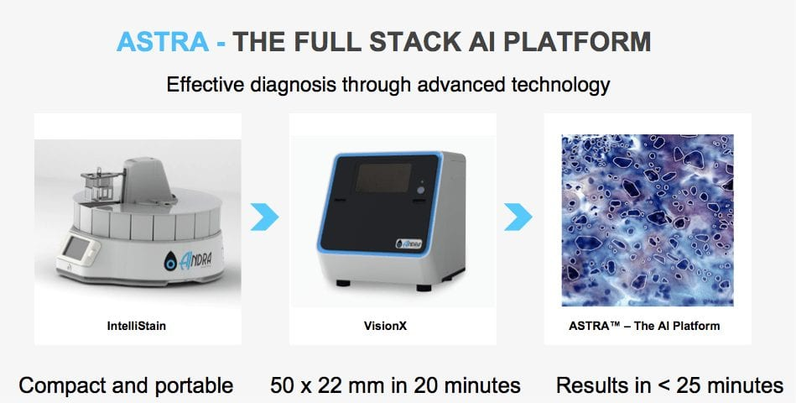
AiNDRA
AI powered MedTech company specializing in computational Pathology and Radiology
Other Products in-line
Aindra Clustr - Collaborative website for Pathologists & Radiologist

Slide 3





Solution Requirements
HMI Software Development Module
HMI software for translation control of actuators, camera controls
Low Resolution Image Capture
To create a software module in order to capture low resolution image and generate region of interest coordinates in imaging device coordinate system.
Multi Slide Acquisition Module
A software module to control a multi slide imaging device. The Module will get input from a low resolution camera and will generate coordinates for capturing each slide placed in the device.
Postprocess Acquired images
Post Processing module to filter, enhance, sharpen images acquired from imaging devices.
Notes:
THESE ARE THE SOL REQUIREMENTS

Slide 4
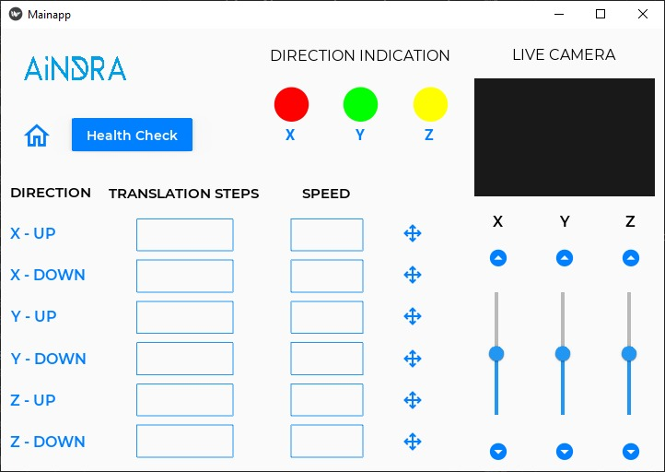
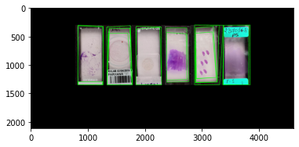
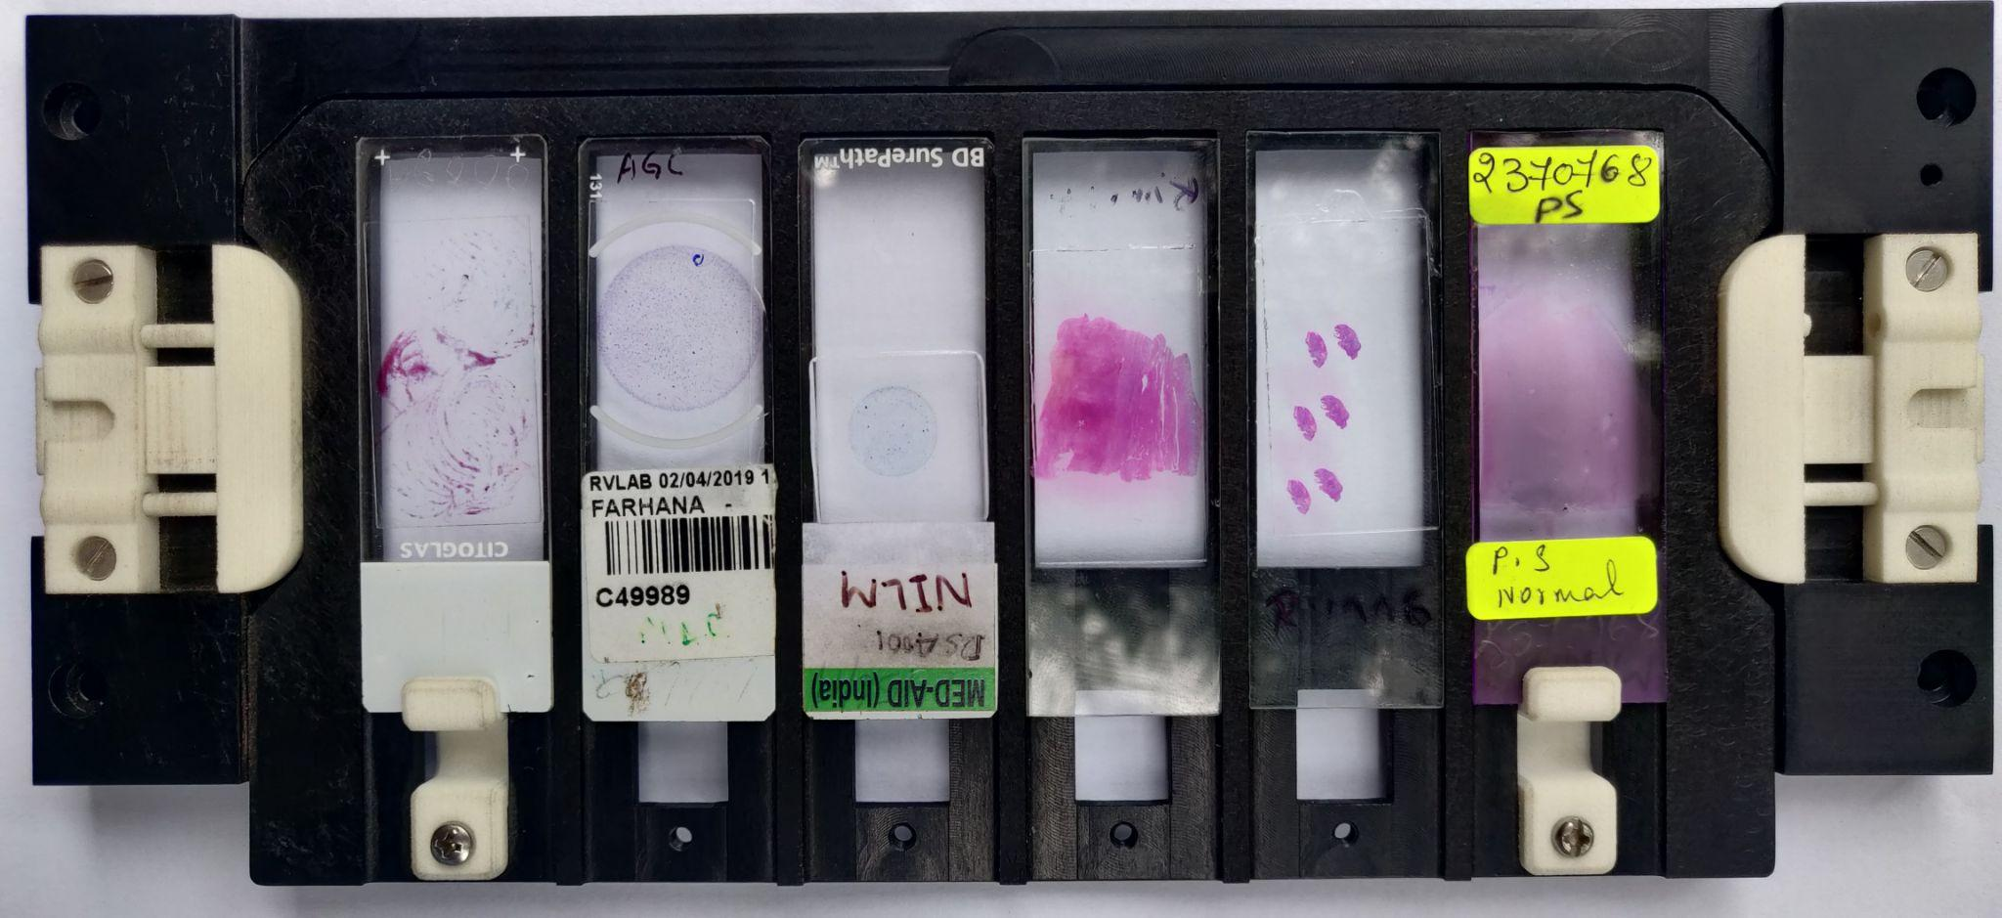
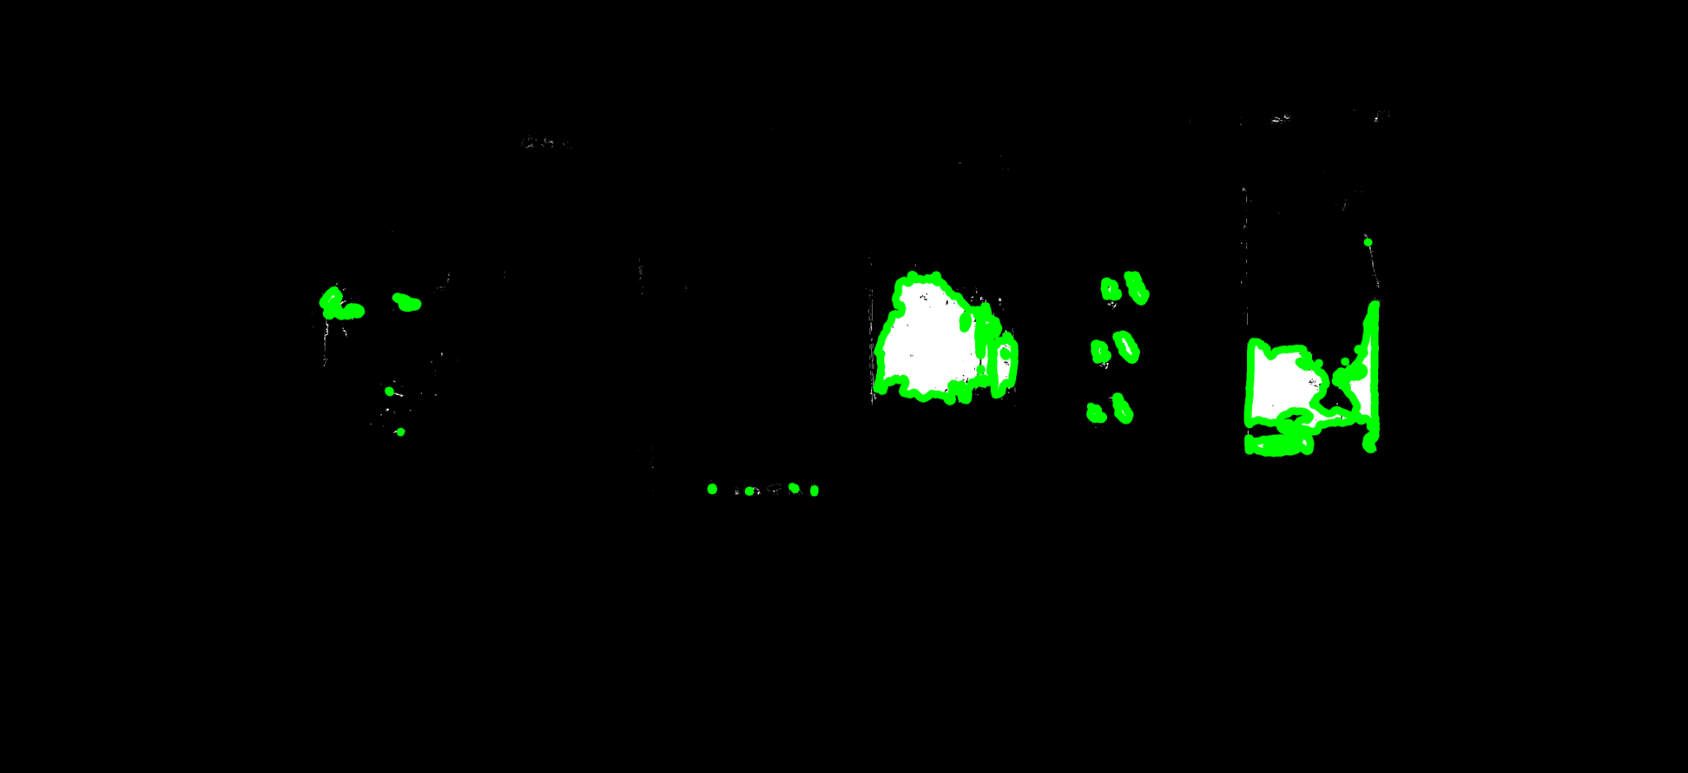
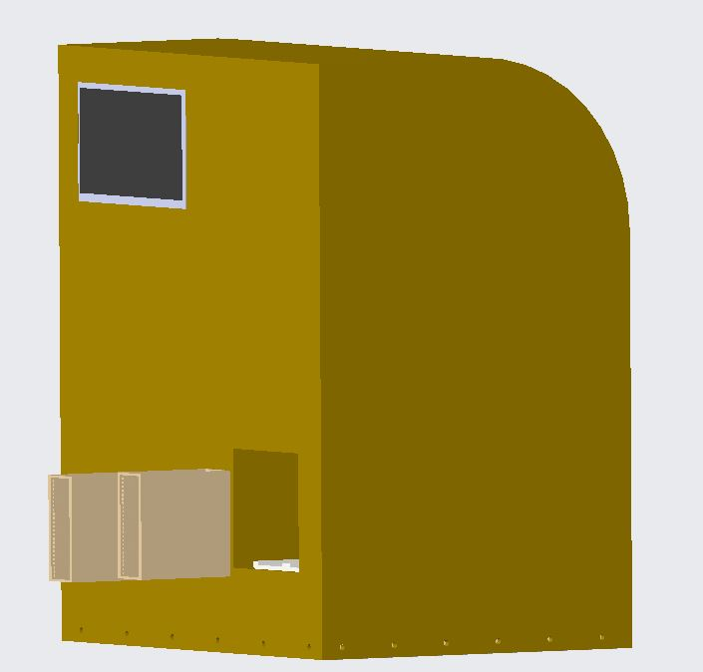
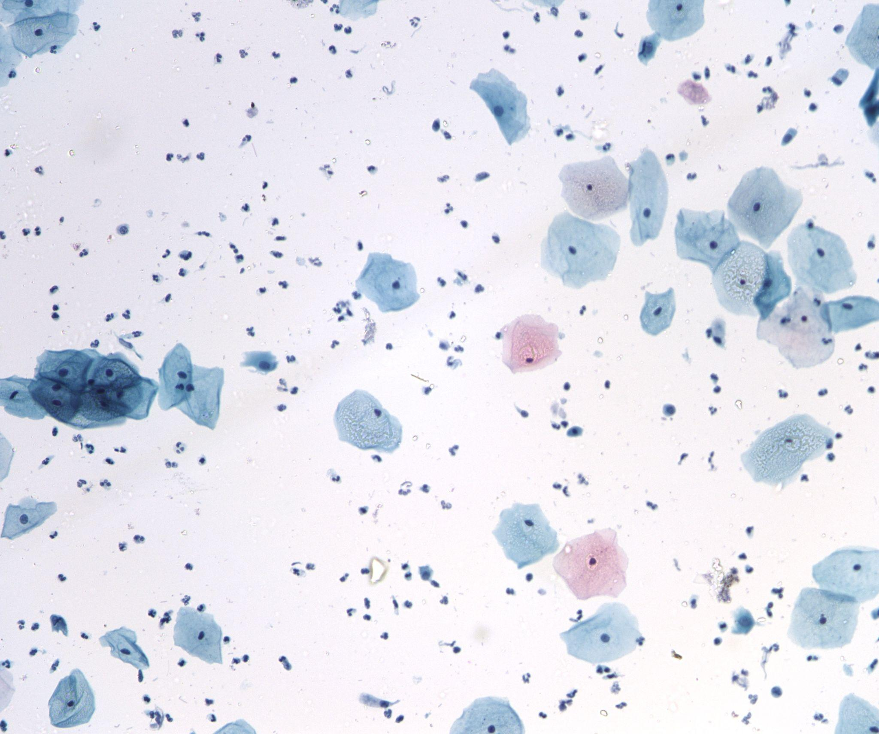
Value addition to AiNDRA
HMI Software Development Module Low Resolution Image Capture
Multi Slide Acquisition Module Postprocess Acquired images

Slide 5
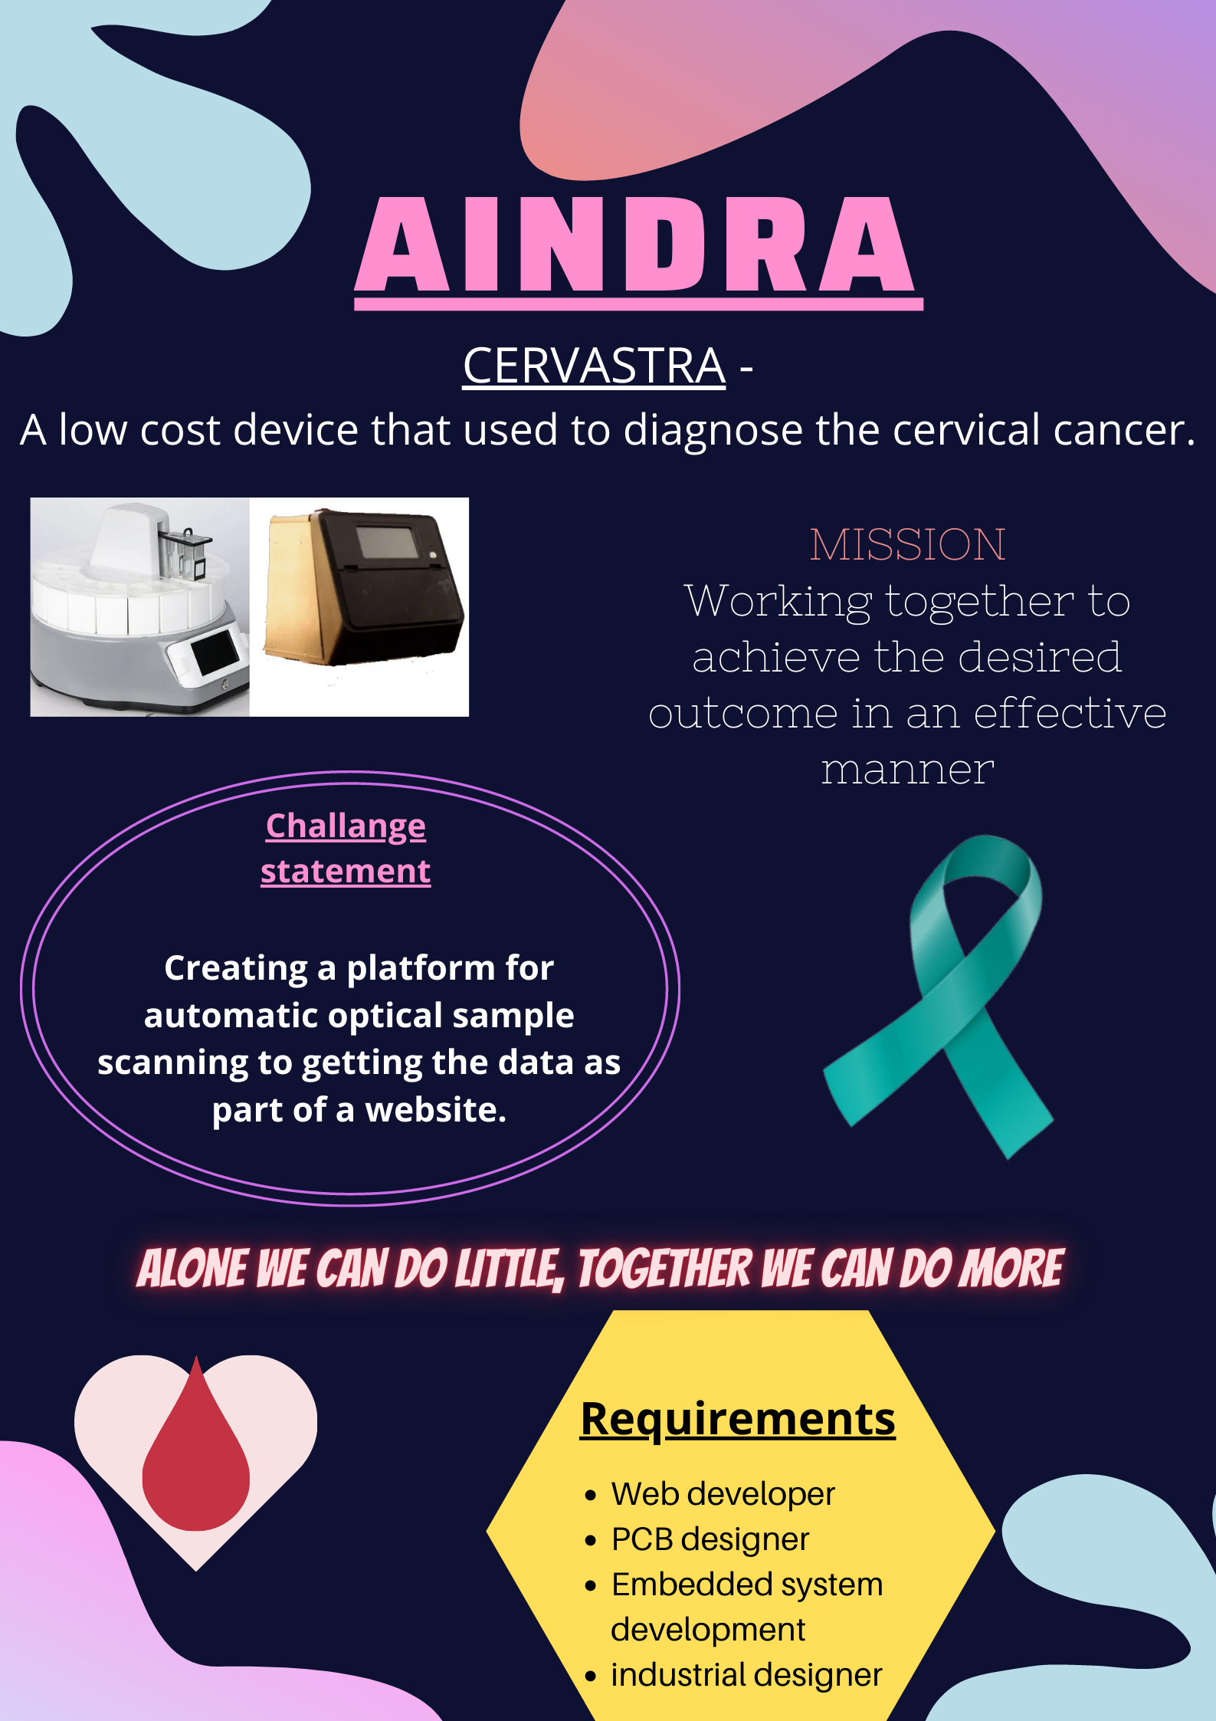
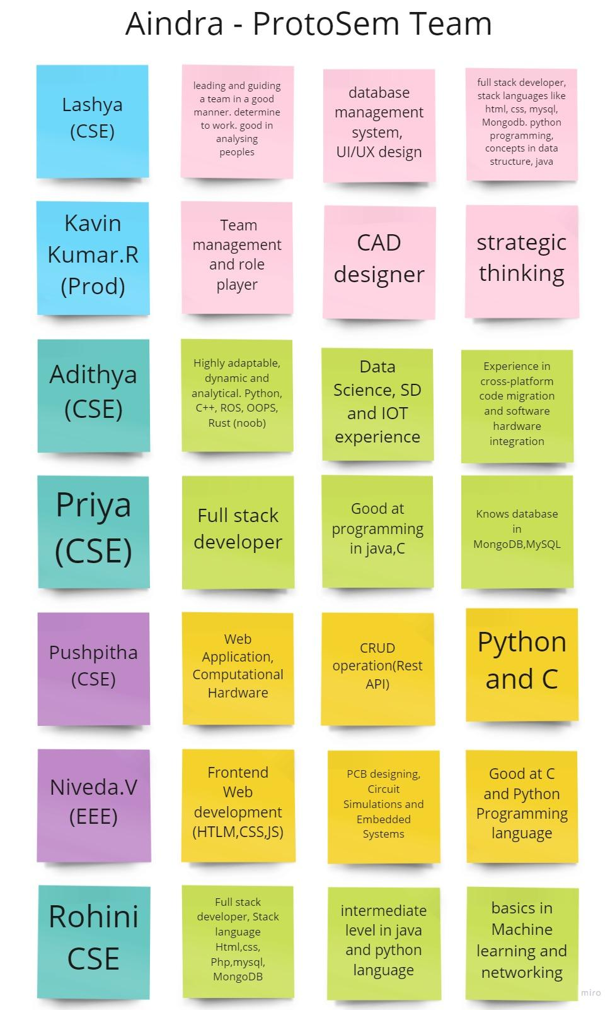
Product Development- Team Formation
Designer
Visionary
Interview process
Team Formation
Hacker
Based on
- Beta teams experience
- Skill set requirements
- Interest

Slide 6
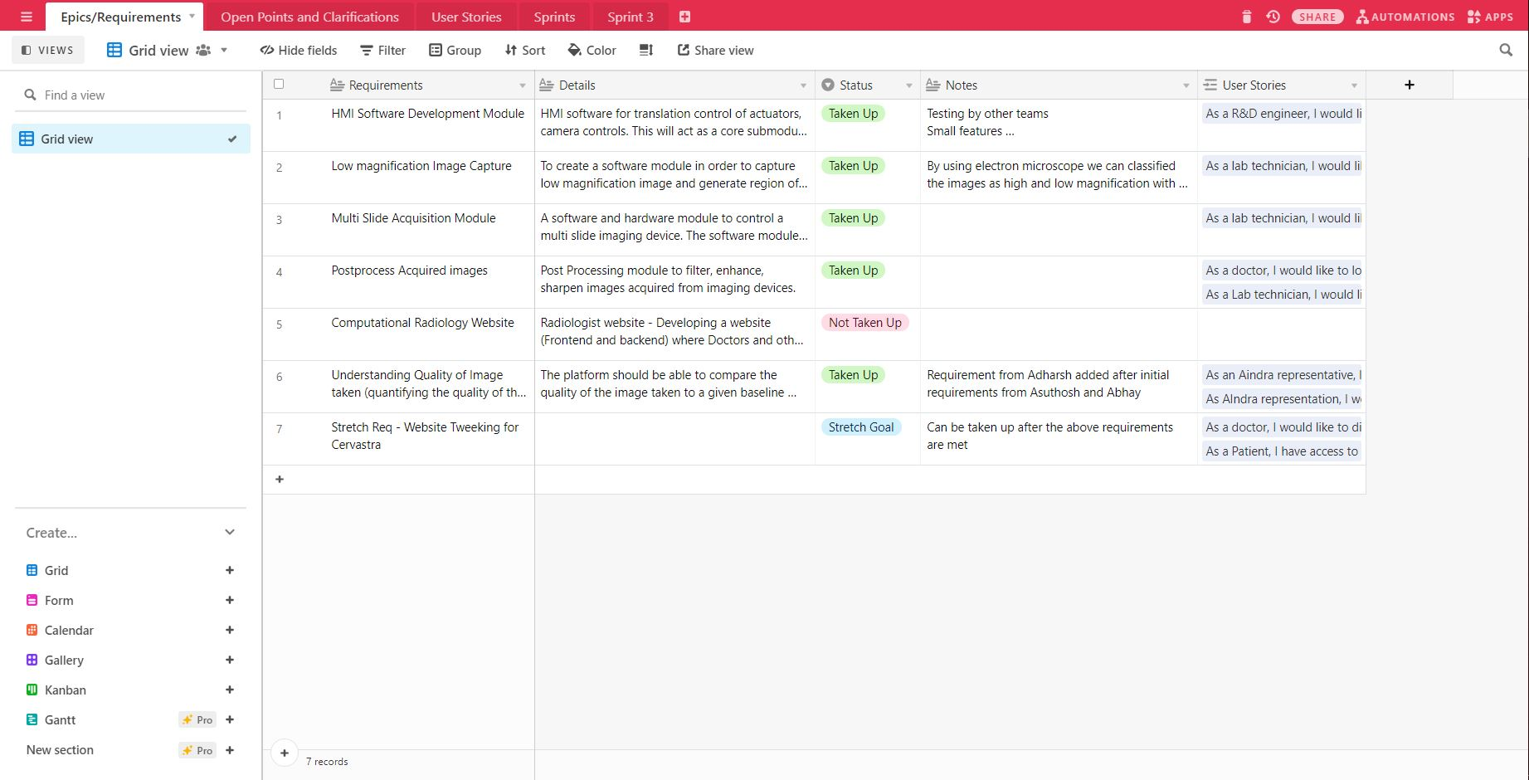
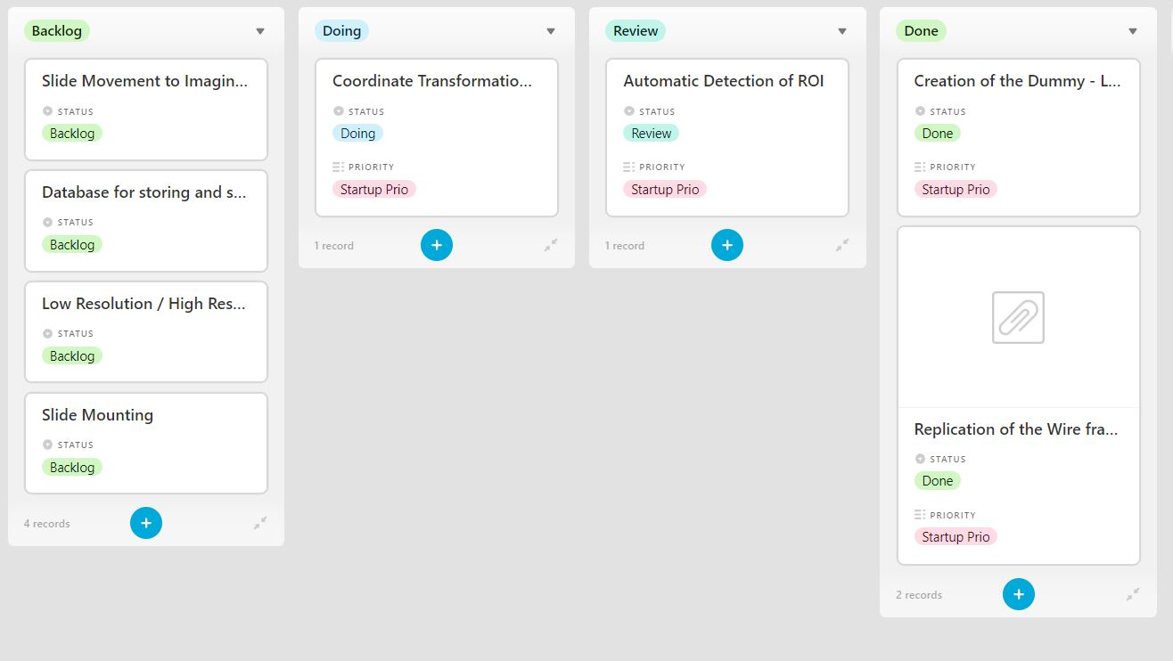
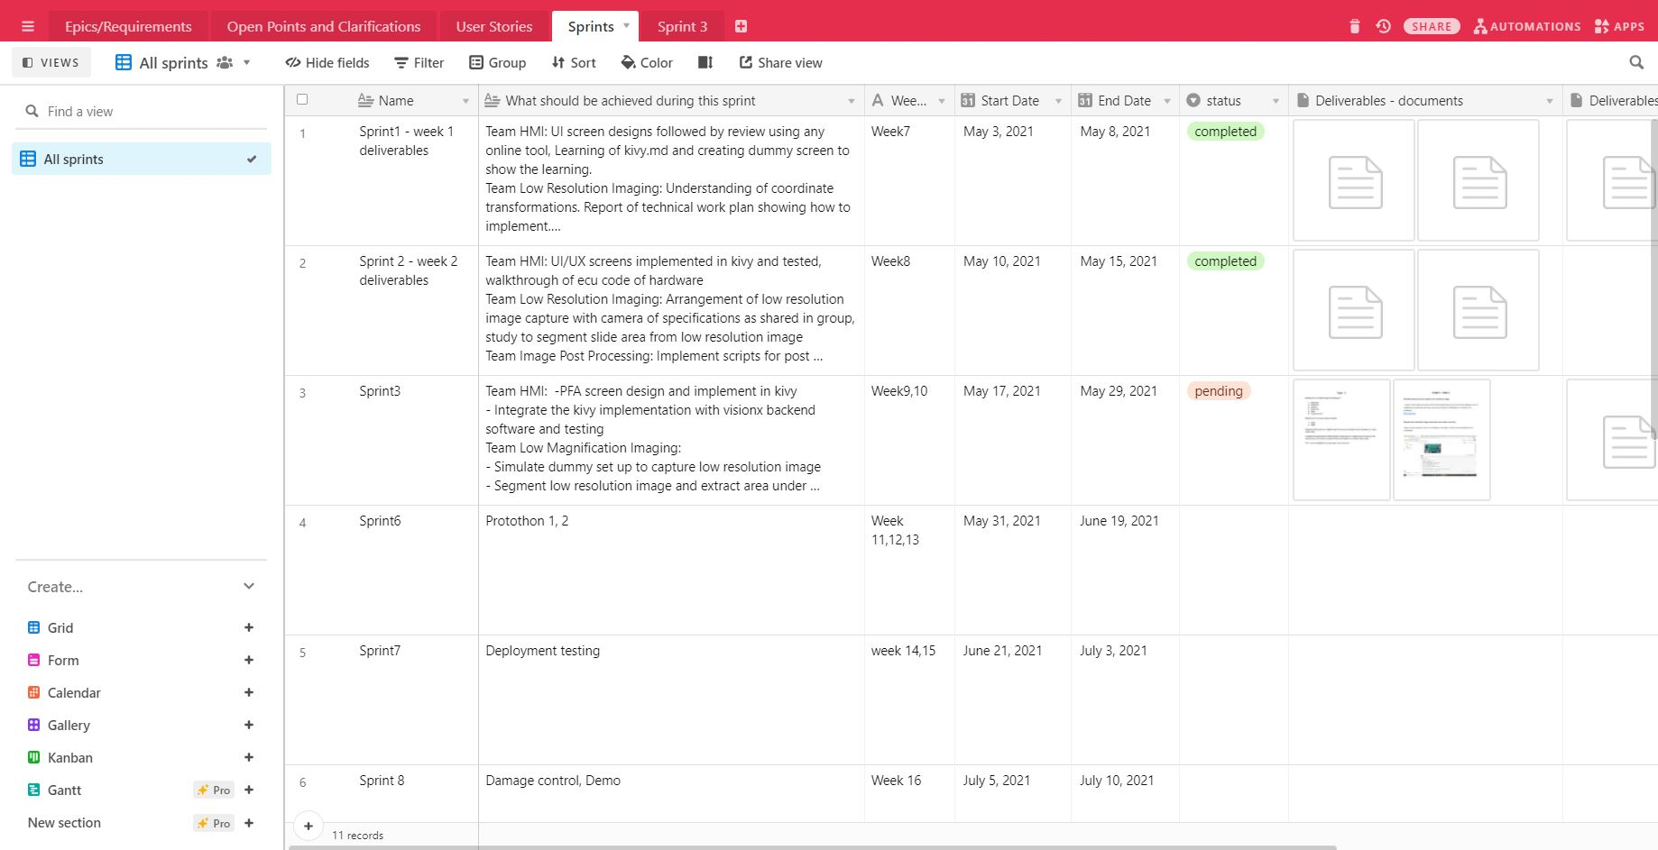
Product Development - Agile Practices

Slide 7
Innovation skills/tools

Slide 8
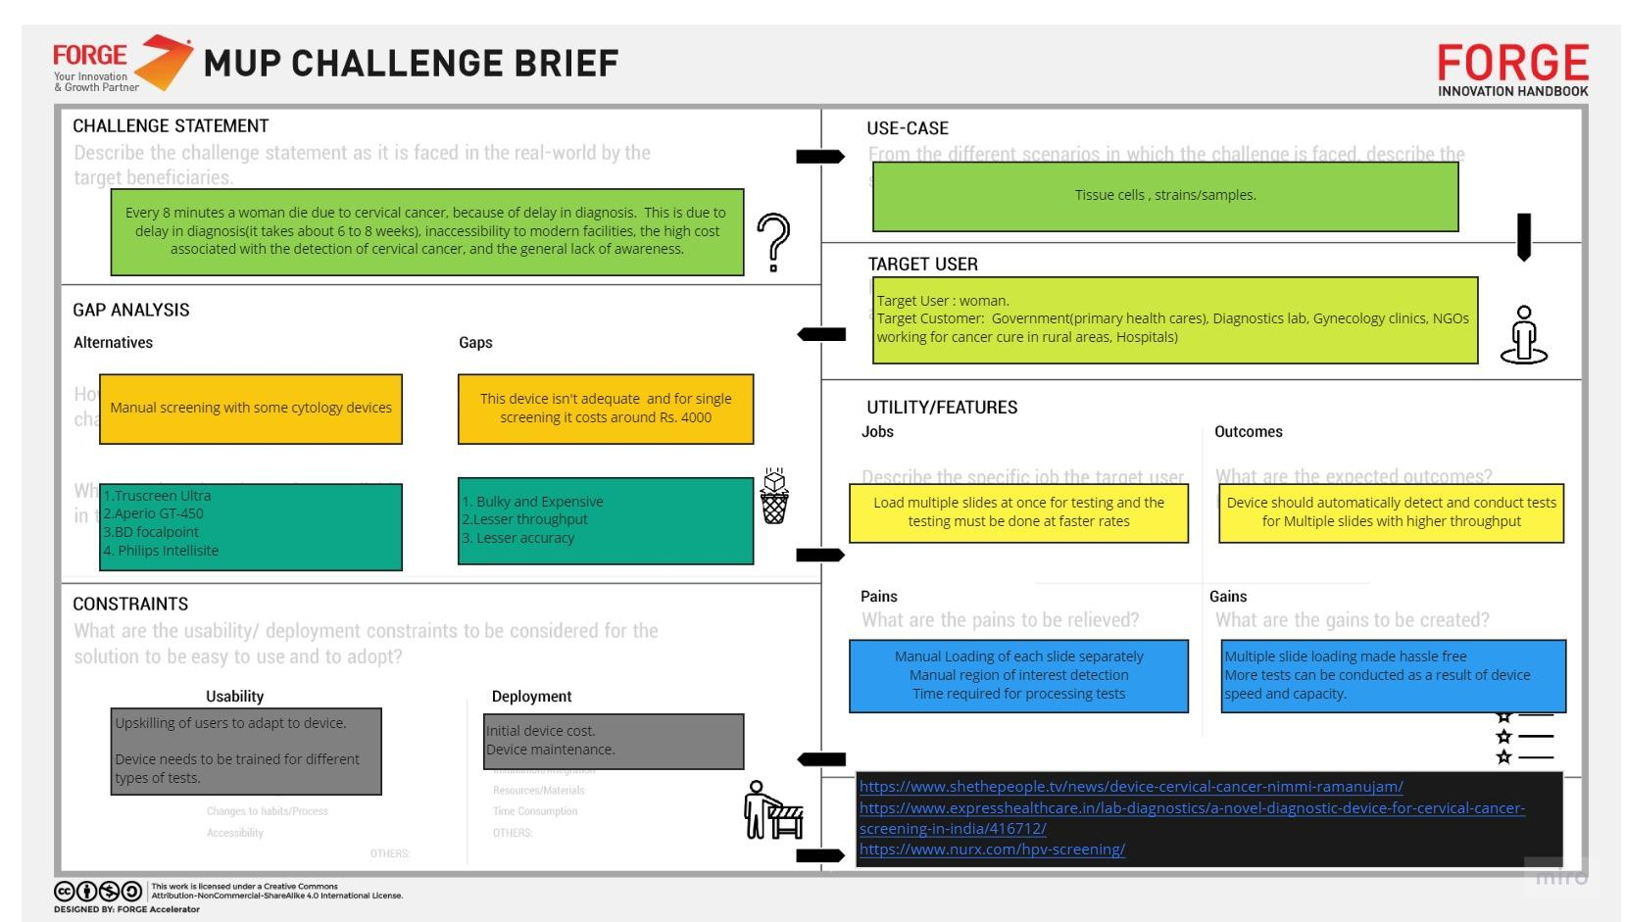
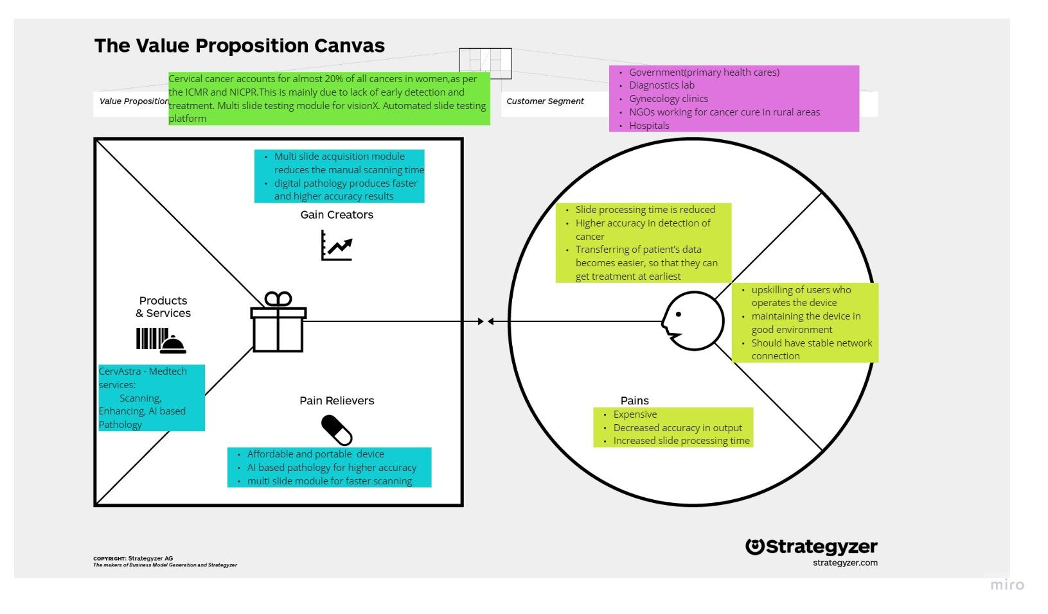
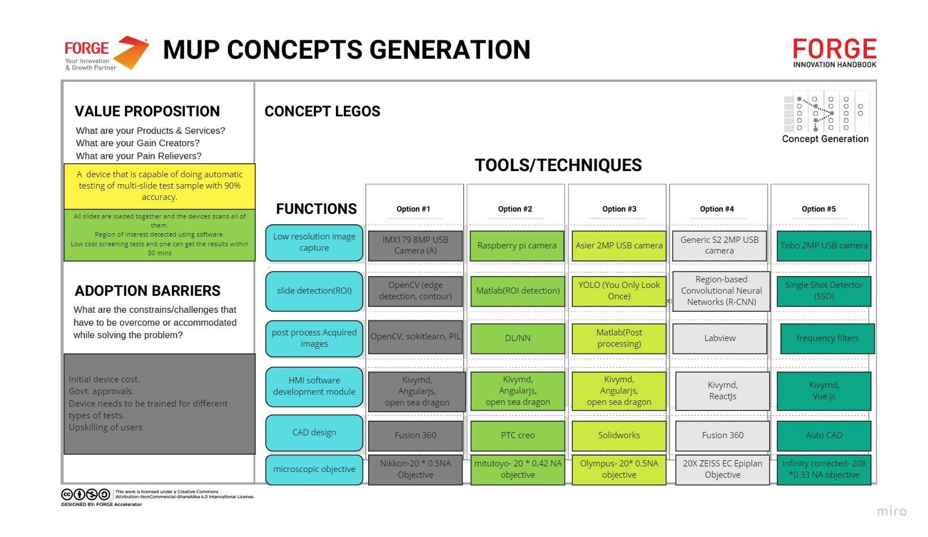
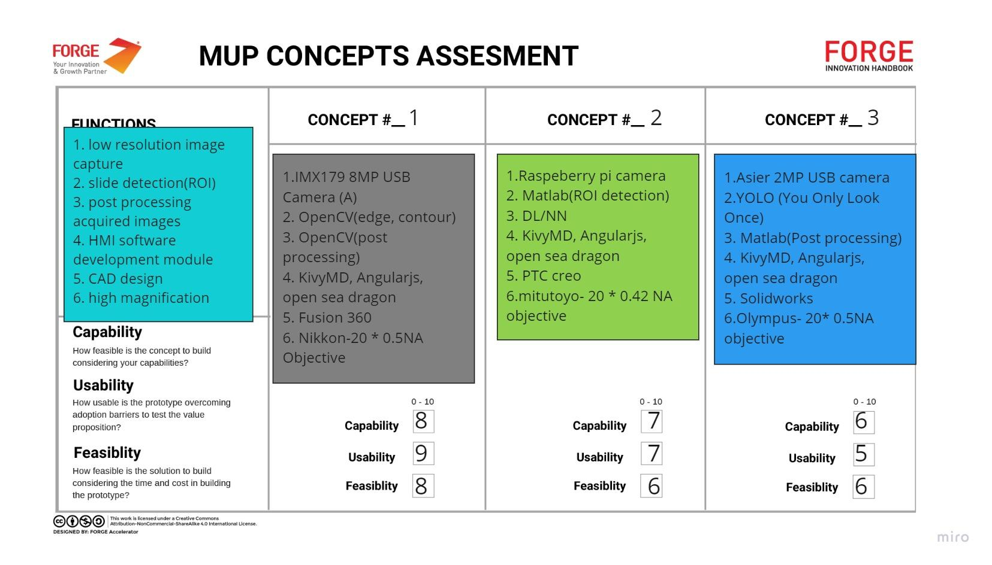


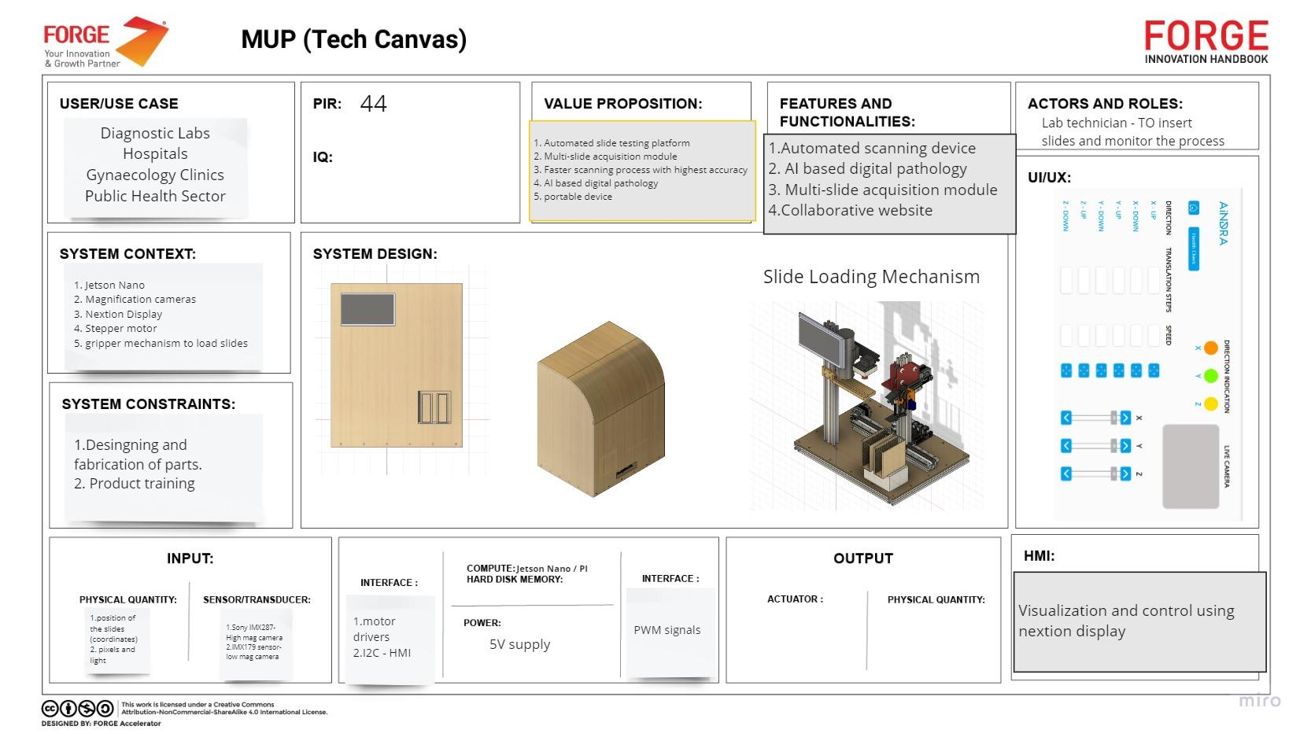
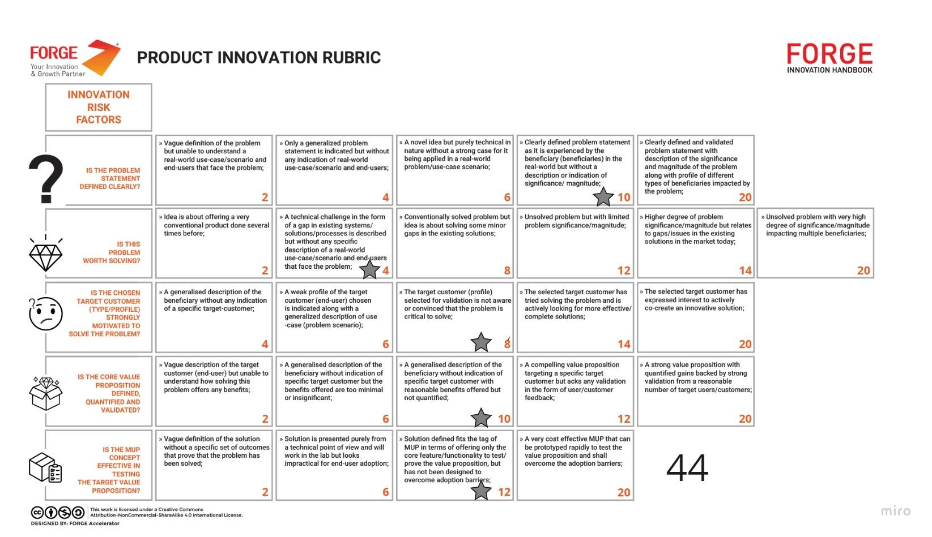
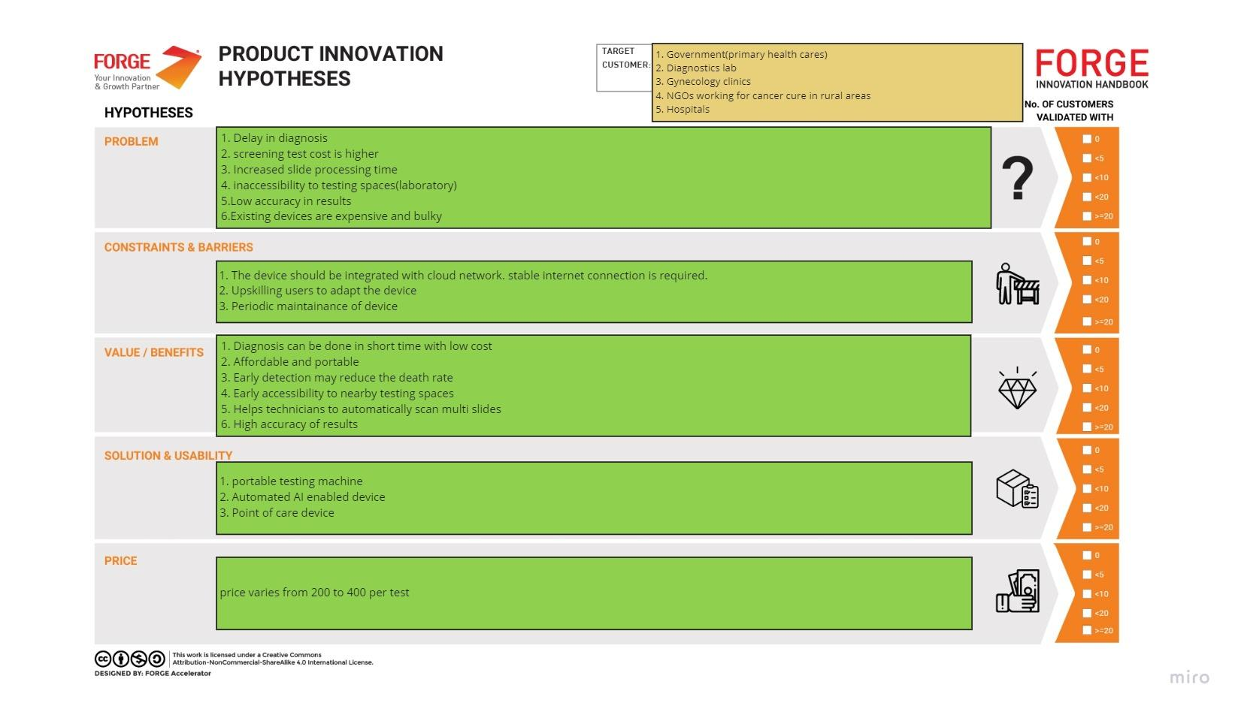
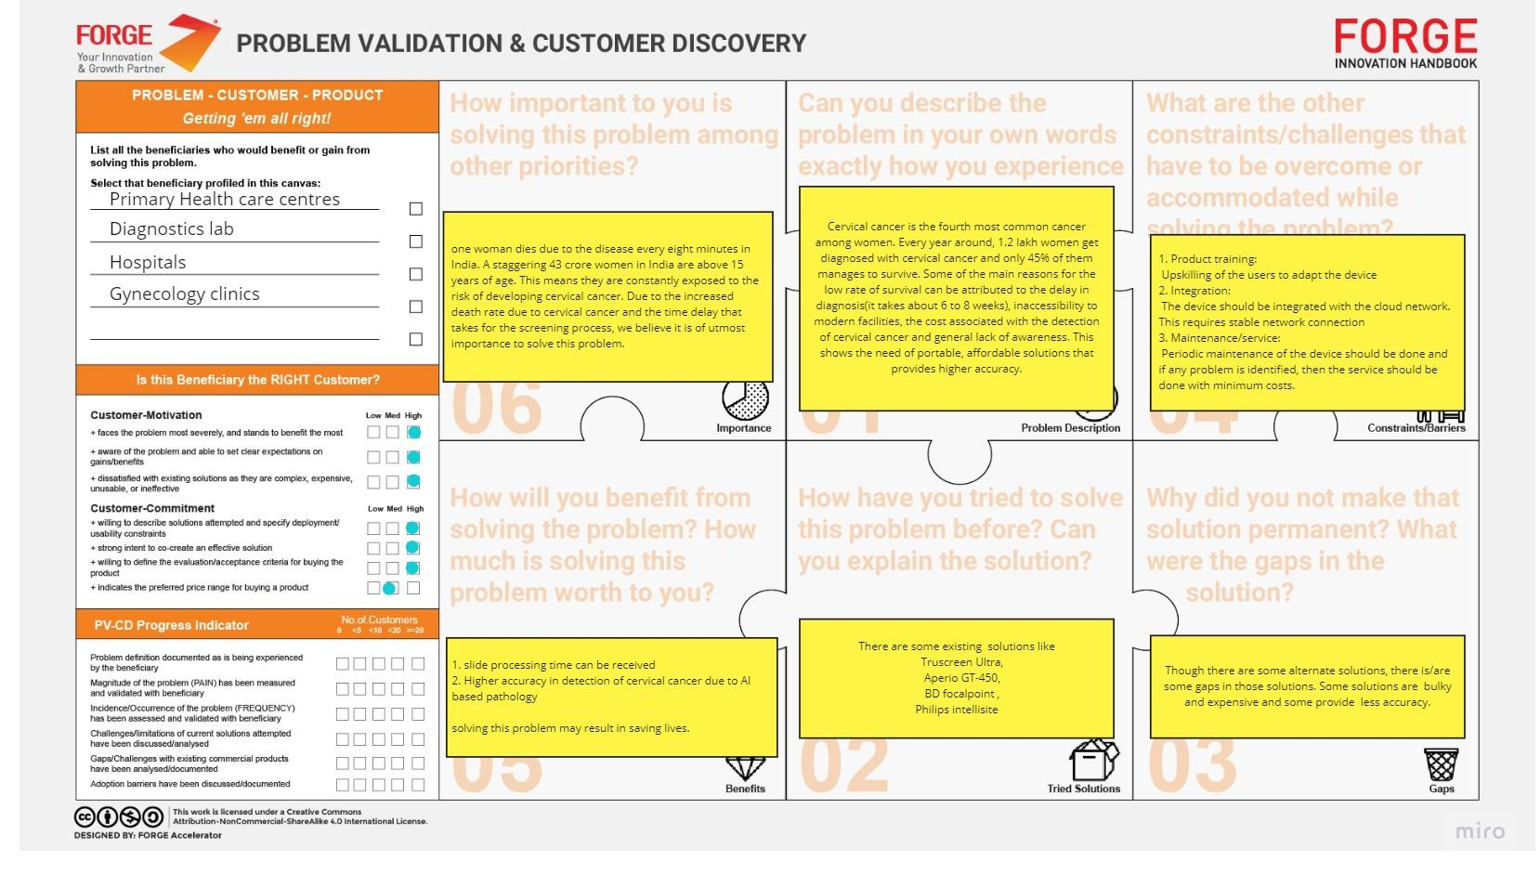
Pains = Pain relievers
Gains = Gain Creators
Value Proposition
MUP Concept Exploration
MUP Concept Assessment
Minimum Usable Prototype
Challenge Brief
Pains = Pain relievers
Gains = Gain Creators
Customer Discovery
PIH
Iteration 1
PIR
Iteration 2
34
44

Slide 9




VALUE PROPOSITION
Distributable point of care testing devices that perform high volume automatic testing of slide mountable autopsies driven by AI - reducing diagnosis time by 98% for critical illnesses (like cervical cancer)
Results in 30 min vs 4-6 weeks
90% sensitivity & 95% specificity
1/10 the price of comparable products
Compatible with existing lab practices

Slide 10
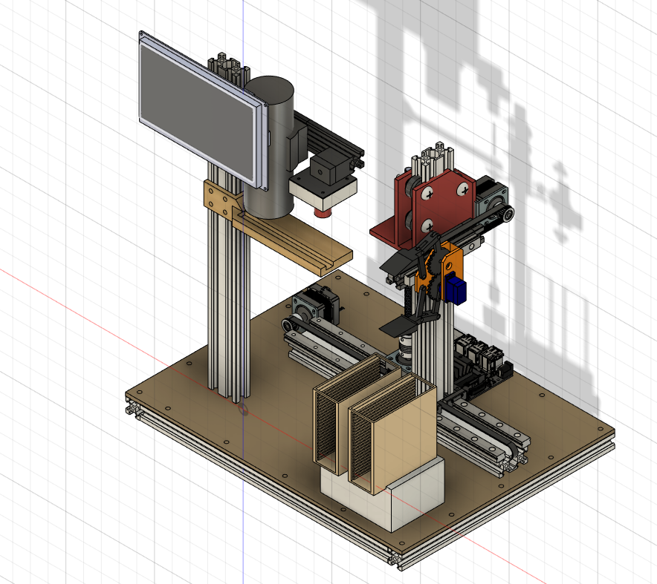
MUP Design - Final iteration
HMI DISPLAY
MICROSCOPIC OBJECTIVE
LOW MAGNIFICATION CAMERA
GRIPPER
EMBEDDED CONTROLLER
(With Vision Processor)
SLIDE STACK

Slide 11
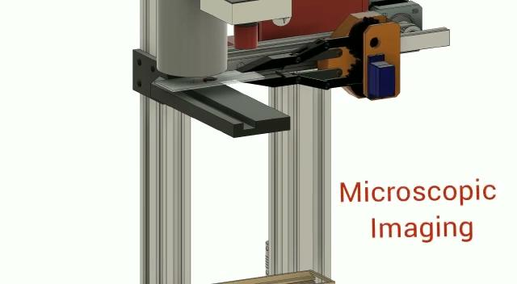
MUP Working Animation
Operation
Loading Stack of Slides
Extraction of slides from stack
Low magnification Imaging
Identifying ROI
High magnification Imaging
Returning Slide to Stack
All Work and Deliverables Shared with the Startup
Bill of Materials for the above MUP is available, MUP has not been built due to Pandemic restrictions

Slide 12
Learnings

Slide 13
Learnings- SW Tools and Technology
KivyMD
UI/UX
Scikit
Open cv
Image denoising
Contour techniques
Edge detection
Post processing
Fusion 360
PIL
System designing
Image Filtering

Slide 14






Learnings- HW Tools and Technologies
3D Printing
Laser cutting
Fabrication
Mechanical Engineering
Embedded systems
Jetson Nano
USB camera
Sensors and actuators

Slide 15
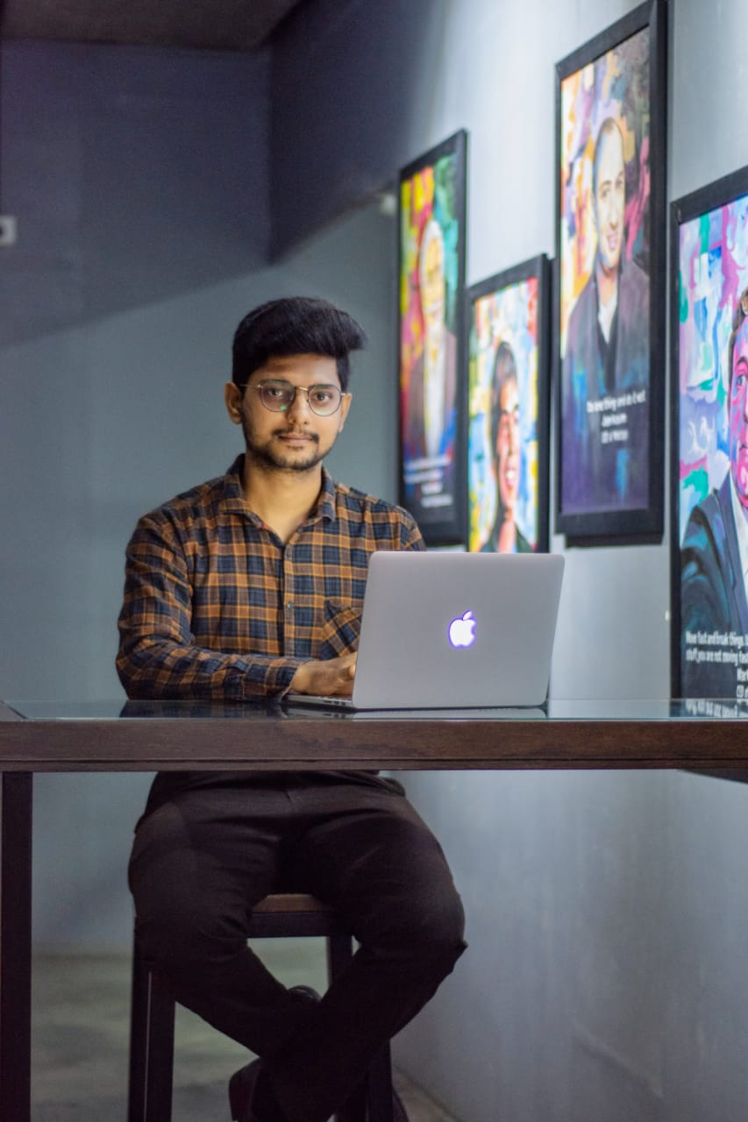
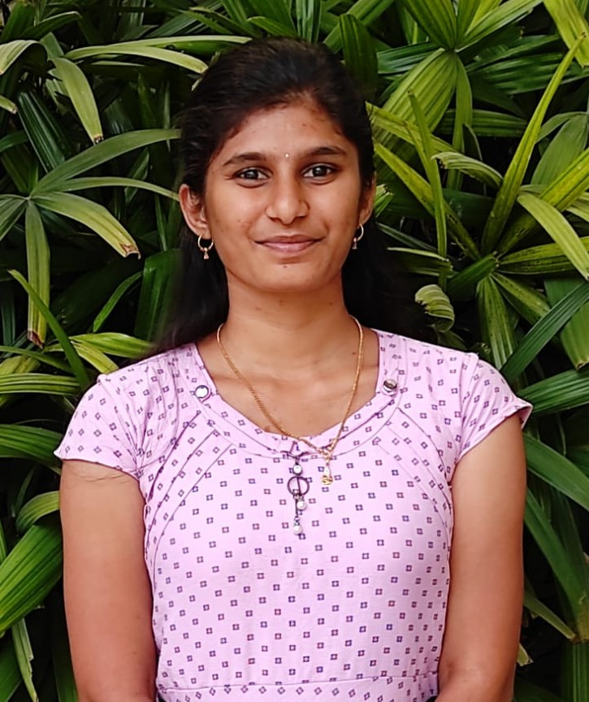
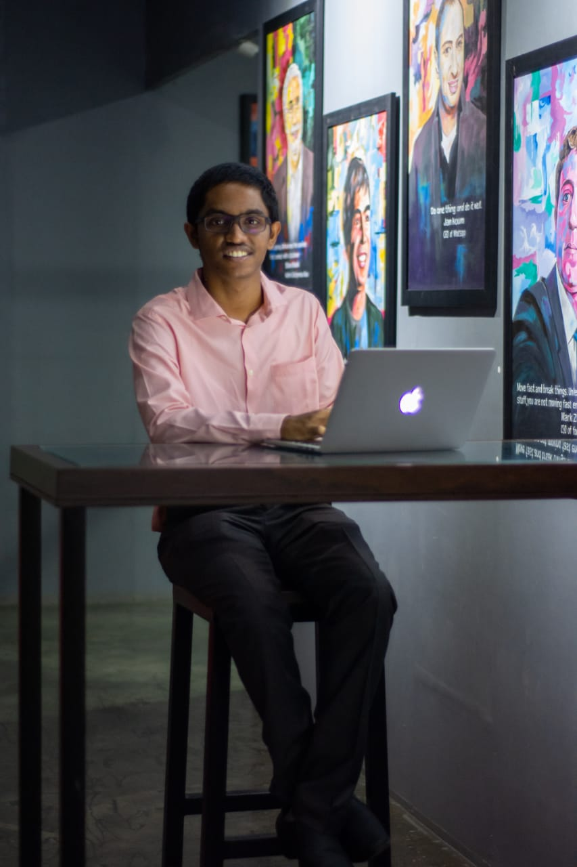
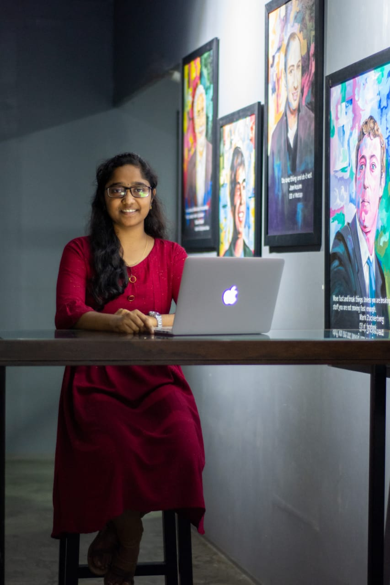

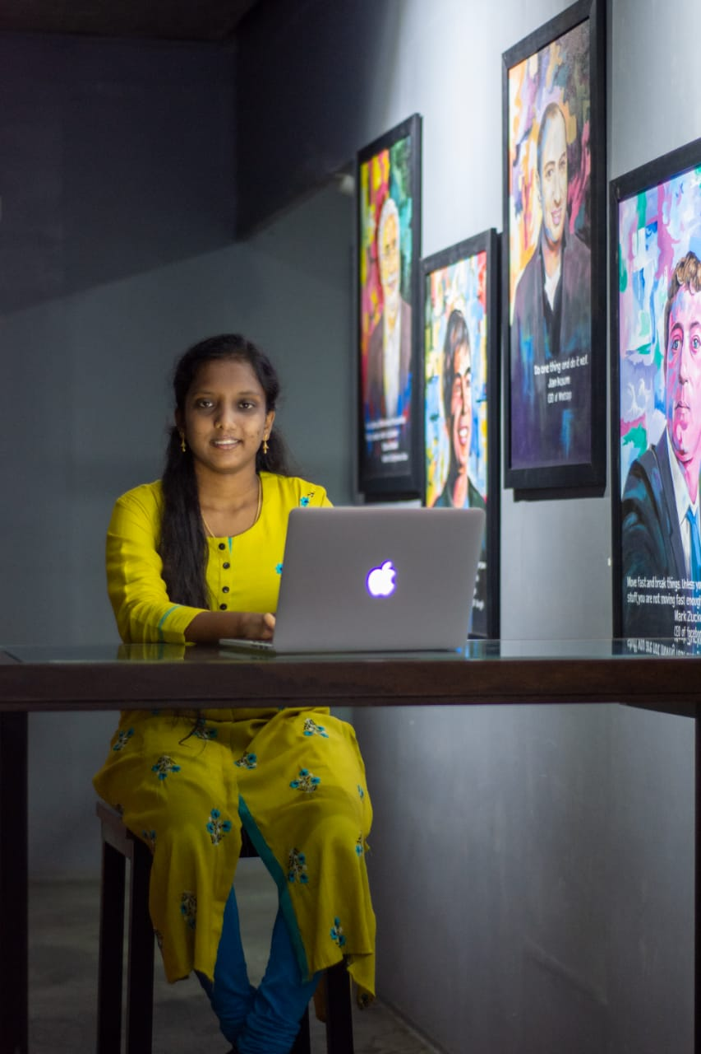
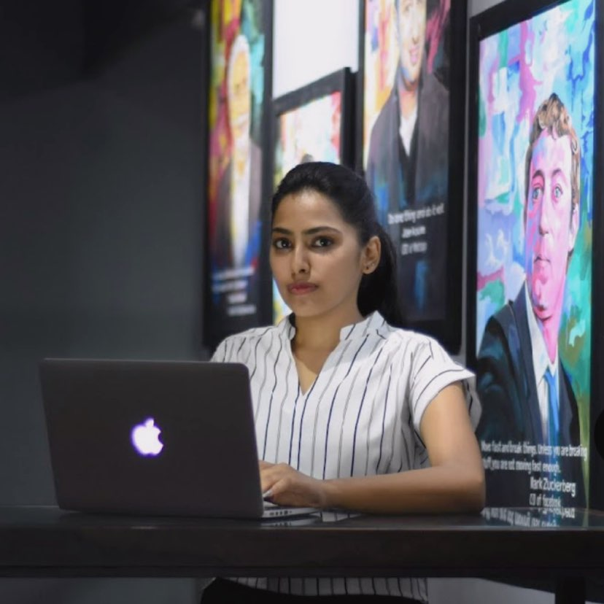
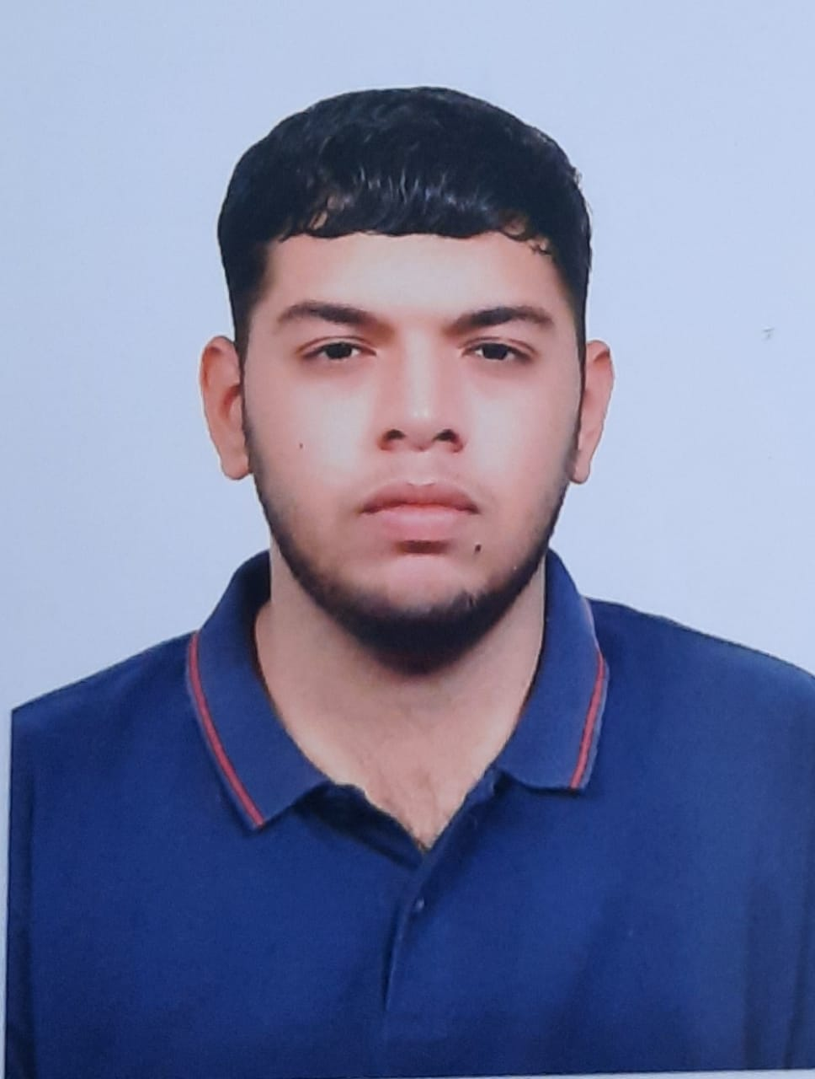
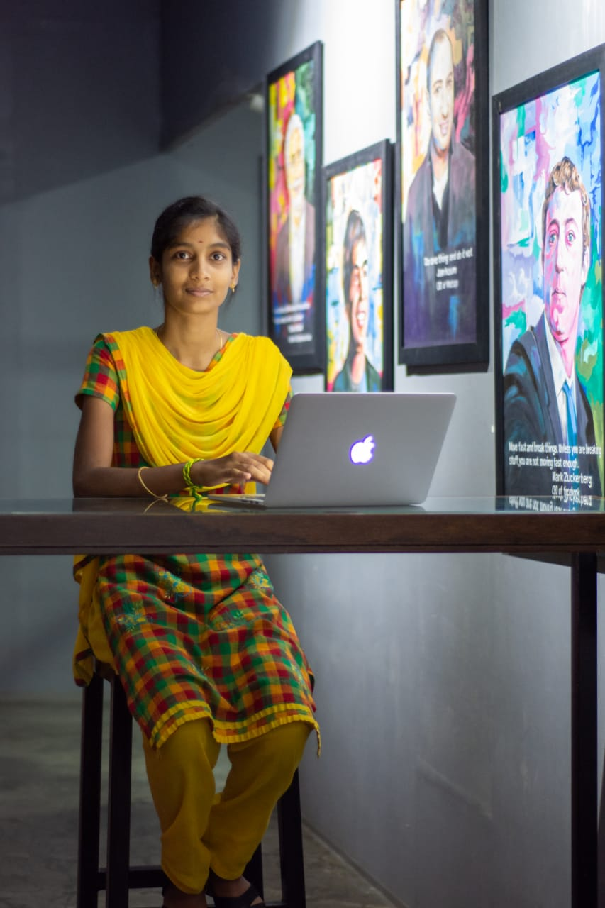
AiNDRA ProtoSem Team
KAVIN KUMAR
Visionary
Production
LASHYA P
Visionary
Computer Science
ADITHYA G
Hacker
Computer Science
ROHINI N
Hacker
Computer Science
VIVEK
Forge
Program Manager
PRIYA S
Hacker
Computer Science
NIVEDA V
Designer
Electrical/Electronics
PUSPITHA P
Designer
Computer Science
KRISHAN
Visionary
Textile

Slide 16
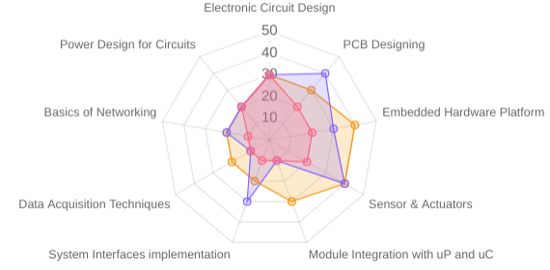
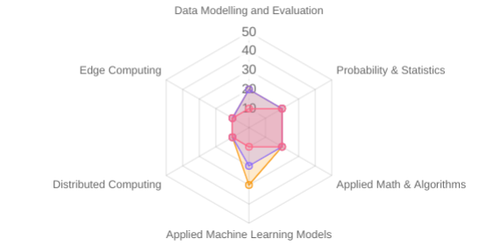
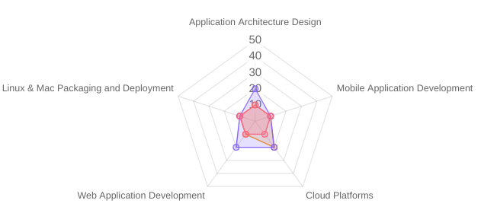
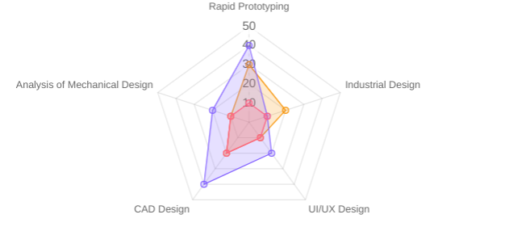
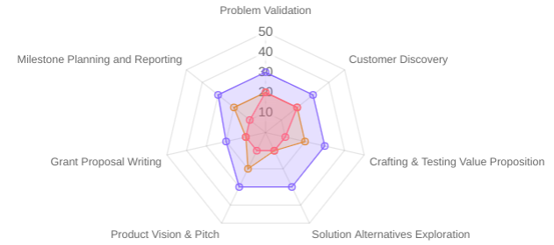
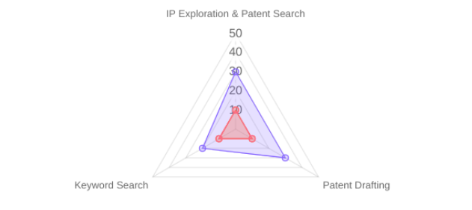
Team Transformation
Hardware/IoT
AI/ML - Data Science
SW Application Dev
Industrial Product Design
Innovation
IP Exploration

Slide 17
THANK YOU

